Slide 1

AI Infrastructure
Ioannis Papapanagiotou
AI Compute

Slide 2
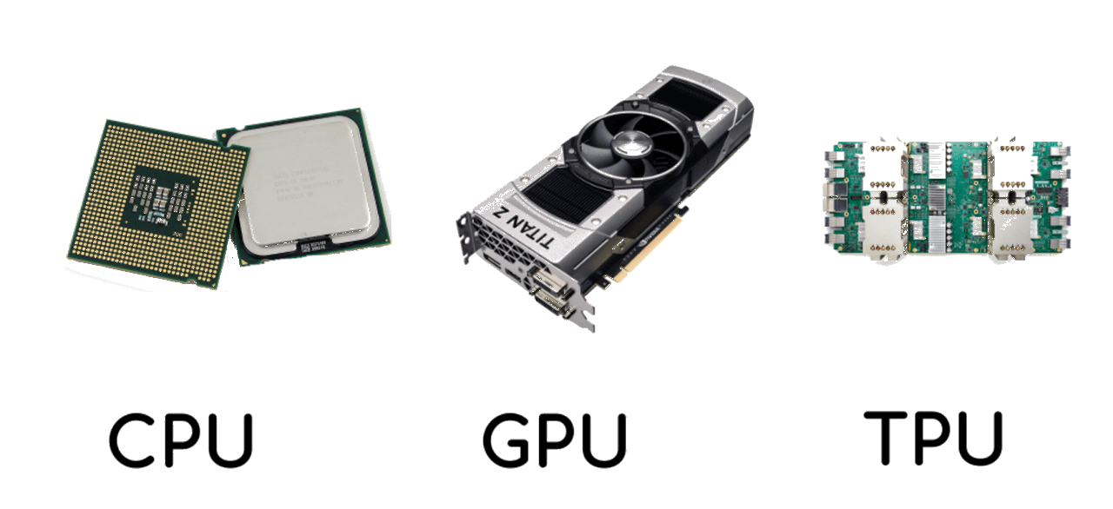
Hardware of an AI Infrastructure
In the realm of AI Infrastructure, hardware components like GPUs, TPUs, and CPUs are the workhorses that power the computational processes underlying AI systems. Their selection and configuration are crucial for the performance and efficiency of AI applications.
Central to AI Processing:
Hardware provides the essential computational capacity required for running complex AI algorithms and processing large volumes of data.
The speed, memory, and processing capabilities of the hardware directly influence the performance of AI models and applications.

Slide 3
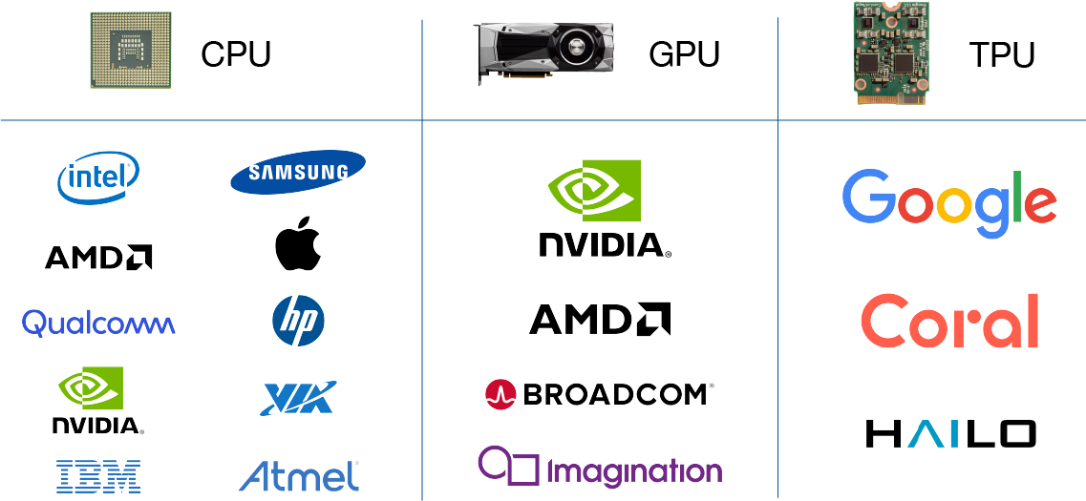
Types of Compute in AI
GPUs: Specialized in parallel processing, GPUs excel in handling the complex mathematical computations needed for machine learning and deep learning tasks.
TPUs: Google's Tensor Processing Units are custom-built to accelerate deep learning tasks, offering high throughput for operations like matrix multiplications, a common procedure in neural networks.
CPUs: While not as fast as GPUs and TPUs in specific tasks, CPUs are versatile and capable of managing a wide range of AI workloads, making them suitable for smaller-scale or less intensive AI applications.

Slide 4
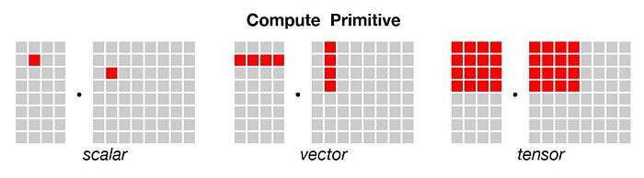
CPUs in AI
A processor designed to solve every computational problem in general fashion.
The Memory and Cache are designed to be optimal for any general programming problem and can handle different programming languages like(C, Java, Python).
The smallest unit of data handled by a CPU at a time is a scalar which is 1x1 dimensional data

Slide 5
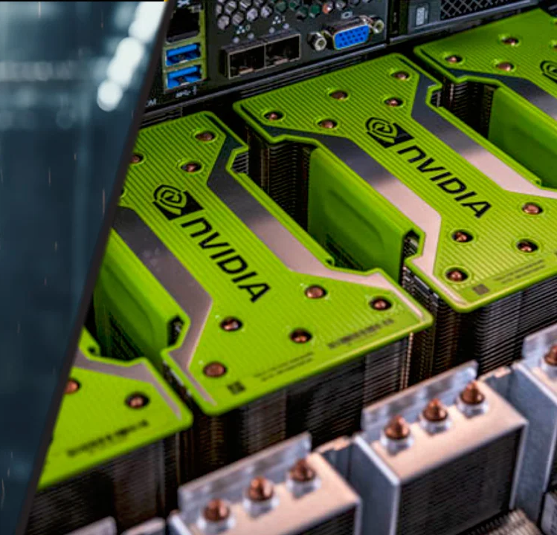
GPUs in AI
A Graphical processing Unit is familiar name to many gamers reading this article.
Initially designed mainly as dedicated graphical rendering workhorses of computer games,
GPUs were later enhanced to accelerate others like photo/video editing, animation, research and other analytical software, which need to plot graphical results with a huge amount of data.
GPUs are a safer bet for fast machine learning because, at its heart, data science model training is composed of simple matrix math calculations, the speed of which can be greatly enhanced if the computations can be carried out in parallel and for this reason GPU has thousands of ALU in single processor, that means you can perform thousands of multiplications and addition simultaneously.

Slide 6
GPUs in AI
They can handle tens of thousands of operations per cycle, the dimension of data is generally 1 x N data unit.
But problem of memory access is still there, Because GPU performs parallel computation on thousands ALUs, so it also spends more energy on memory accessing. To overcome this problem Google designed TPU.

Slide 7
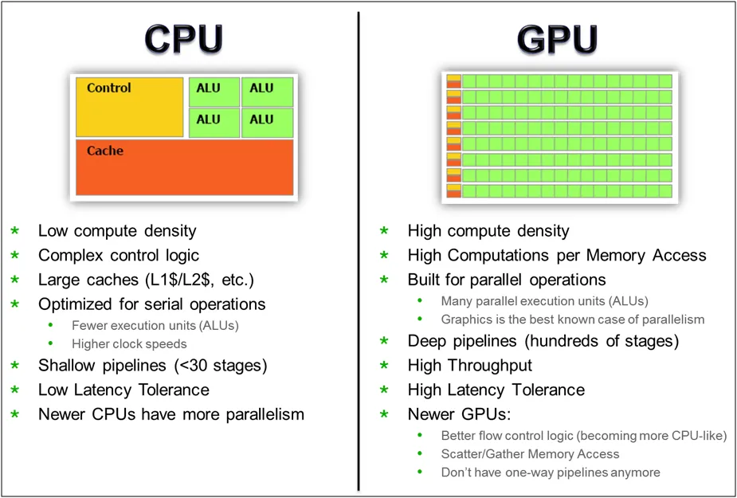
CPUs and GPUs
CPUs are best at handling single, more complex calculations sequentially, while GPUs are better at handling multiple but simpler calculations in parallel.

Slide 8
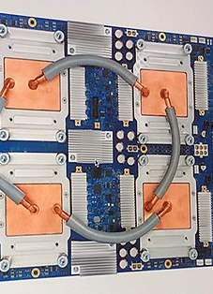
TPUs in AI
Tensor processing Unit (TPU) is a ASIC processor which is Application Specific Integrated Chip designed to accelerate deep learning tasks developed using Tensorflow framework.
While their cores are adept at simple computations, complex logic handling falls outside of their skillset.
Recognizing this, Google introduced Tensor Processing Units (TPUs) in 2016, explicitly designed to handle intensive AI workloads.

Slide 9
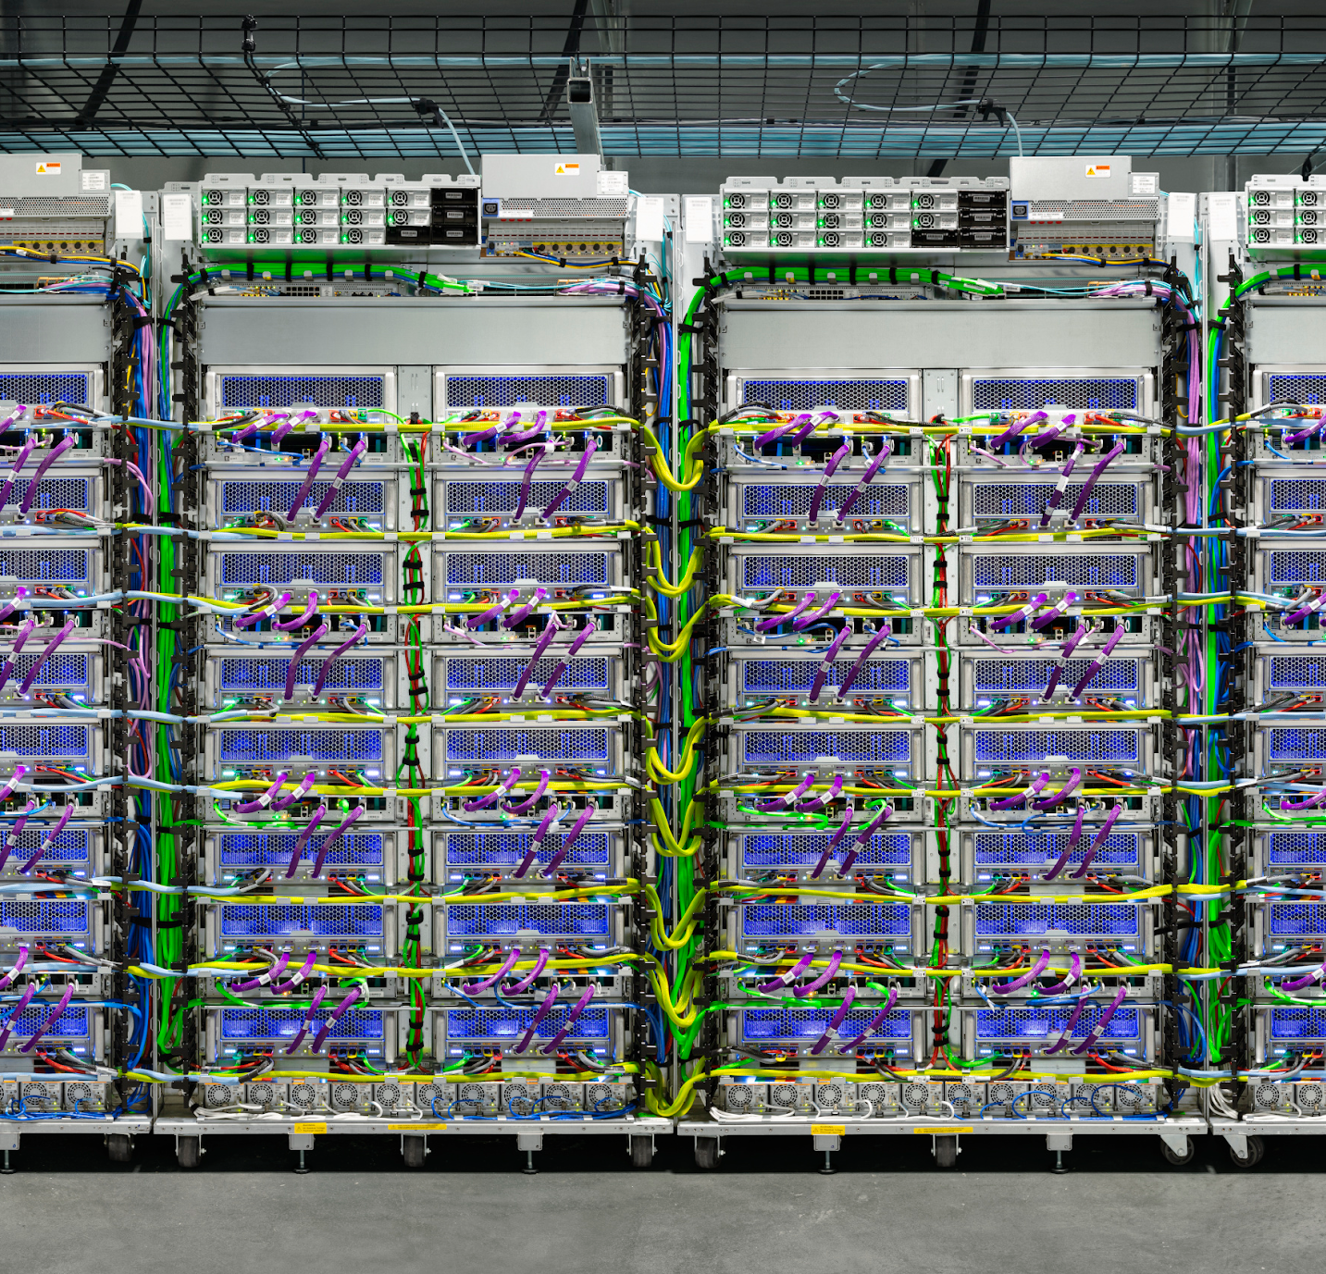
TPUs limitations
It’s not a generic processor. It can only handle tensorflow model on it.
TPU solved the memory access problem.
It loads the parameter from memory into the matrix of multipliers and adders.
TPU loads the data from memory. As each multiplication is executed, the result will be passed to next multipliers while taking summation at the same time. So the output will be the summation of all multiplication result between data and parameters.
During the whole process of massive calculations and data passing, no memory access is required at all.
This is why TPU can achieve high computational throughput on neural network.

Slide 10
Where things are going?
The emergence of TPUs is a sign of a general trend. Rather than building models and worrying about how to run them later, chip-aware machine learning is emerging as a paradigm.
We are bound to see chips emerge which are increasingly better specialized to execute the operations on which AI models rely.
New emergent capacities are bound to emerge as we push the boundary of the possible with specialized mechanics.

Slide 11
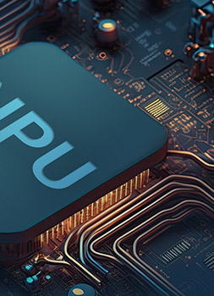
Neural Processing Units
Neural processing units (NPUs) are specialized chips that are designed to accelerate the processing of neural networks.
Neural networks are a type of AI that mimic the structure and function of the human brain.
They consist of layers of interconnected nodes, called neurons, that process and transmit information.
NPUs are optimized to perform the mathematical operations that are involved in neural network processing, such as matrix multiplication and convolution.
NPUs can be integrated into CPUs, GPUs, or ASICs, or they can be standalone chips.

Slide 12
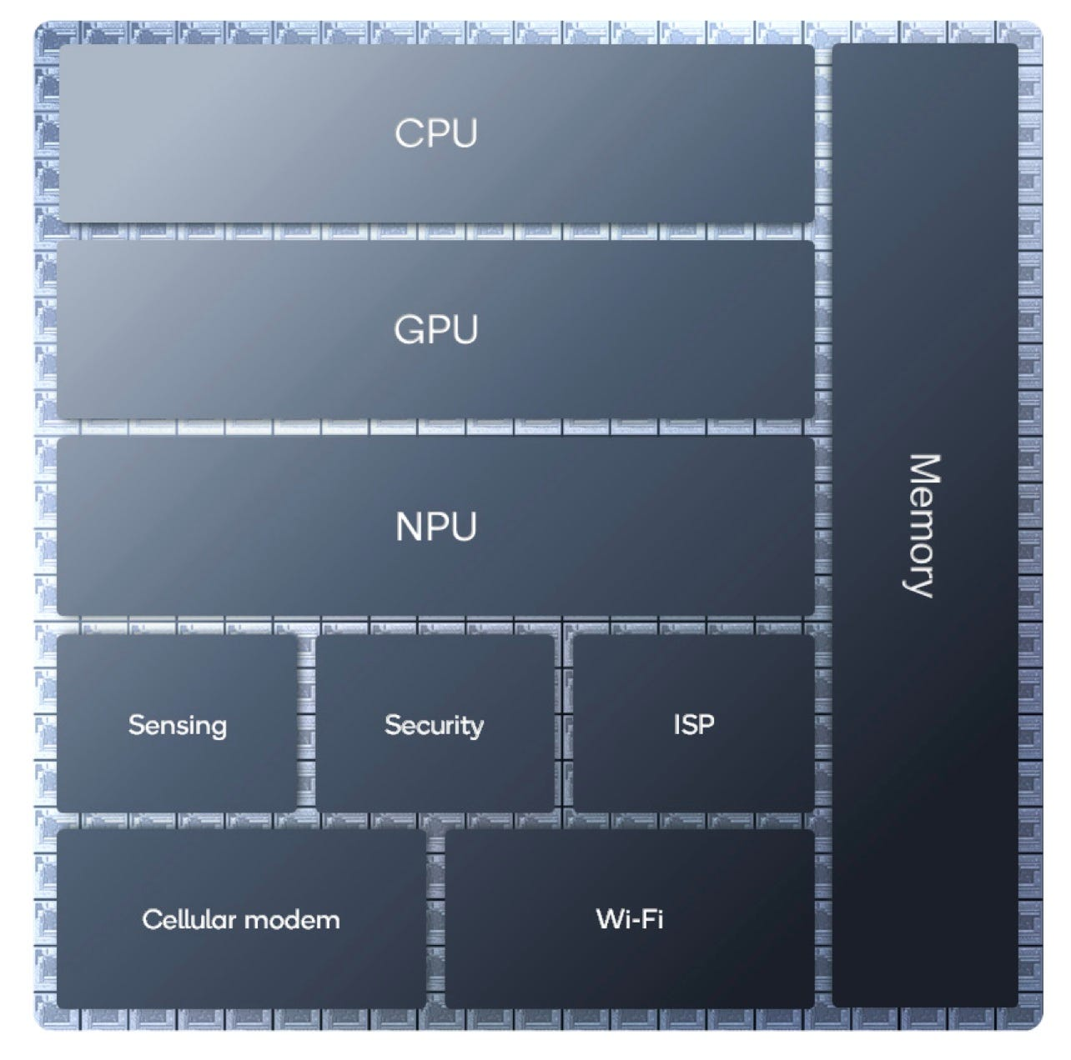
Is NPU/TPU a chip?
Not usually. Unlike, Google’s TPUs, NPUs aren’t normally separate chips. Instead, they are a distinct block of circuits on a System-on-Chip, the single silicon die that contains all of the processing capacity needed to power a modern personal computer or smartphone.

Slide 13
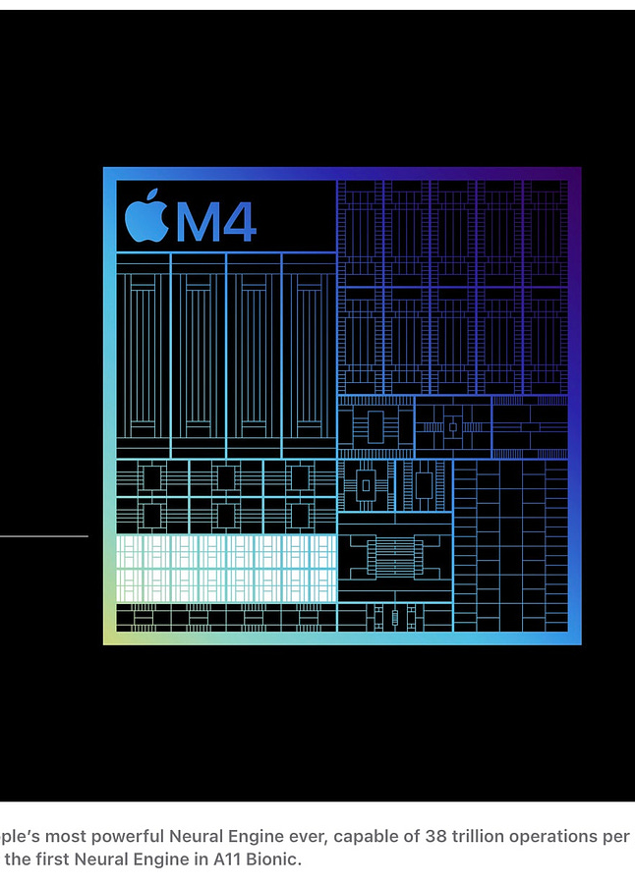
Apple M4 chip
When announcing the M4 chip, used in the latest iPad Pro, Apple provided a stylized image portraying the location of the NPU on the SoC silicon die.
Even allowing for the approximate nature of this portrayal we can see that the NPU takes up a non-trivial part of the M4’s die.
Having the NPU on the same die as the CPU means that the NPU will be cheaper to make and more power efficient than if it was on a separate chip.

Slide 14
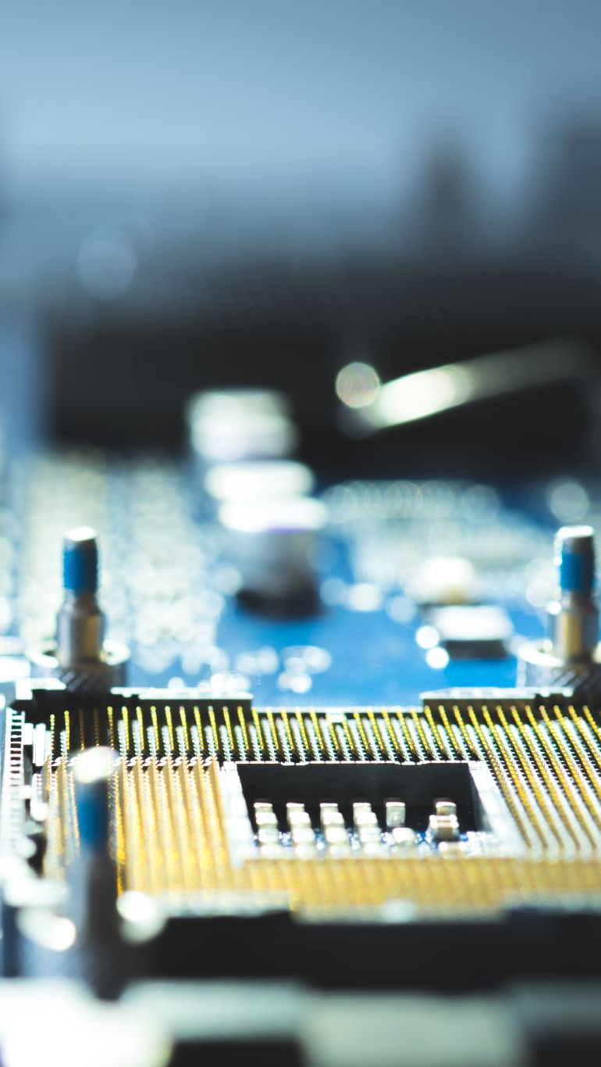
Why would anyone want an NPU?
This is great, but inference can be done by any standard ‘general purpose’ CPU. However, having a specialized piece of hardware has three main advantages when performing the calculations needed for inference. It can:
Speed them up, and;
Reduce the amount of power they need, and;
Free up the CPU to perform other tasks.
Faster inference means a more responsive PC or smartphone and lower power means better battery life on mobile devices, both of which are important in improving user experience. These improvements may make machine learning practical where otherwise it might have, for example, been too slow to be useful.

Slide 15
I’m not use AI on my PC or Smartphone. Why do I need an NPU?
You may not be using applications that identify as using AI but there is a very, very high probability that you are that you are already using machine learning inference routinely. It’s providing features that we take for granted in applications that we use every day, such as:
Facial and voice recognition;
Blurring the background in photo editing and Zoom calls;
Predictive typing on smartphone keyboards;
Optical character recognition in scanned documents.
And many, many more!
In all of these examples, NPUs have the potential to improve the user experience.

Slide 16
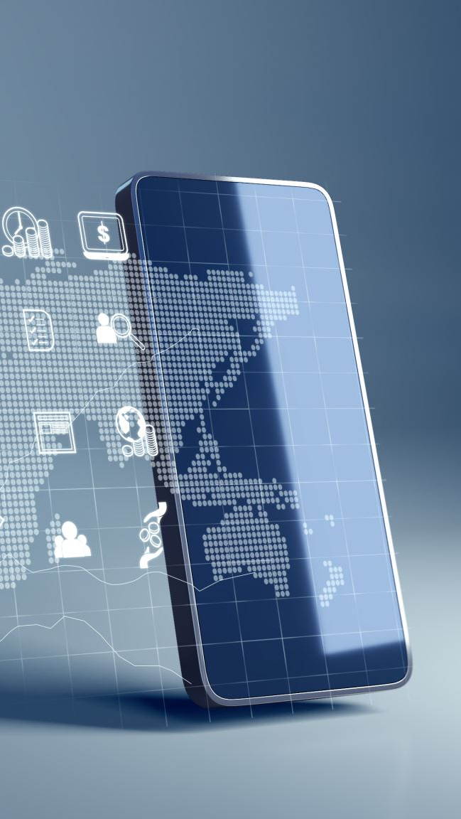
I use ChatGPT, can I use NPUs to speed up inference?
Most well-known and popular Large Language Models (LLMs) like ChatGPT and its competitors use hardware in the cloud to perform inference and don’t (yet) use NPUs on your PC or smartphone.
However, with the right software, there is no reason why an NPU shouldn't be used to accelerate inference for LLMs running ‘locally’ on your PC.

Slide 17

GPU can perform inference. I have a GPU. Why do I need an NPU?
Well known LLMs such as ChatGPT often use GPUs from Nvidia to perform inference in the cloud. And your PC or smartphone will always include a GPU.
Nvidia has been successfully turning its GPUs into devices that are highly effective accelerators for machine learning training and inference.
It has done this through the development of both a high-quality software ecosystem (centered on CUDA) and through the refinement of its hardware, including adding specialized tensor matrix multiplication units to its GPUs.
Other GPU designers have either not done this or have been much less effective in doing so.
Plus the GPU on your PC or smartphone is already needed to perform its original function: drawing images on your display.
What happens if your device needs to draw some complex graphics and perform machine learning at the same time? Having a separate NPU removes this potential contention.

Slide 18
Back to TPUs
Tensor processing units (TPUs) are also specialized chips that are designed to accelerate the processing of neural networks.
However, unlike NPUs, TPUs are not based on the traditional von Neumann architecture, which separates the memory and the processing units.
Instead, TPUs use a novel architecture, called systolic array, which integrates the memory and the processing units into a single chip.
This allows TPUs to perform parallel computations faster and more efficiently than NPUs.

Slide 19
NPU vs TPU
Architecture:
NPUs use the traditional von Neumann architecture, which separates the memory and the processing units. TPUs use the systolic array architecture, which integrates the memory and the processing units into a single chip.
Performance:
NPUs have a higher peak performance than TPUs, but they also have a higher latency and power consumption. TPUs have a lower peak performance than NPUs, but they also have a lower latency and power consumption.
Cost:
NPUs are more expensive than TPUs, because they require more components and more complex designs. TPUs are cheaper than NPUs, because they require fewer components and simpler designs.
Availability:
NPUs are more widely available than TPUs, because they are produced by many companies, such as Intel, Nvidia, Huawei, and Samsung. TPUs are less widely available than NPUs, because they are produced by only one company, Google.

Slide 20
Applications
Cloud computing:
NPUs and TPUs can be used to provide cloud-based AI services, such as image recognition, natural language processing, and speech synthesis.
For example, Google Cloud offers TPU-based AI services, such as Cloud Vision, Cloud Natural Language, and Cloud Text-to-Speech.
Edge computing:
NPUs and TPUs can be used to enable edge-based AI applications, such as face recognition, voice control, and gesture recognition.
For example, Huawei's Kirin 990 chip integrates an NPU that can power edge-based AI applications on smartphones and other devices.
Autonomous vehicles:
NPUs and TPUs can be used to support autonomous driving systems, such as object detection, lane detection, and path planning.
For example, Tesla's Full Self-Driving chip uses an NPU that can process 2300 frames per second and support 12 cameras and 8 radars.
Healthcare:
NPUs and TPUs can be used to enhance healthcare services, such as diagnosis, treatment, and monitoring. For example, Google's Health TPU can help detect diseases, such as diabetic retinopathy and breast cancer, from medical images.
Notes:
https://medium.com/@craigadebanji46/npu-vs-tpu-the-future-of-ai-hardware-explained-c532c12913fd

